Slide 1


Slide 2
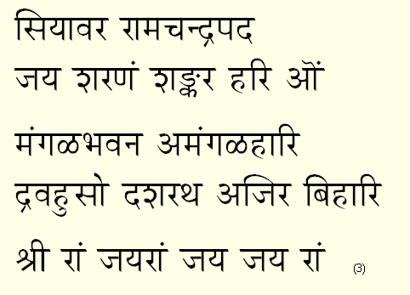
Please Switch off cell phones
Rest Rooms are downstairs
Each Doha ends with
www.sfsai.org

Slide 3
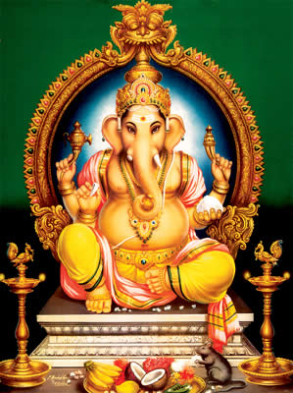

Slide 4


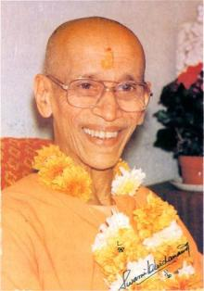

Swami Sivananda
Swami Chidananda
www.sfsai.org

Slide 5


Slide 6
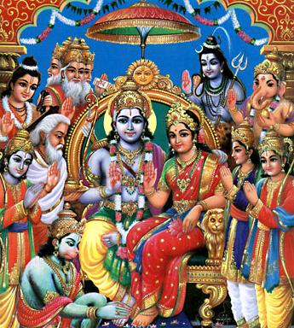

Slide 7
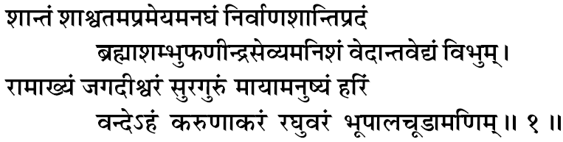
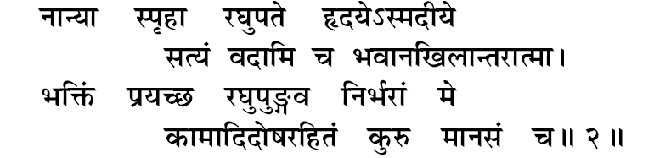
www.sfsai.org

Slide 8





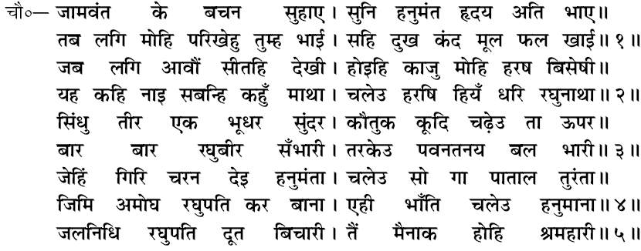
www.sfsai.org

Slide 9
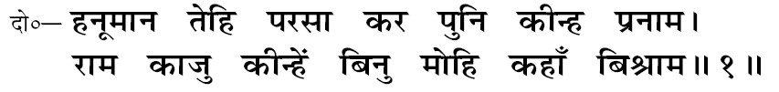

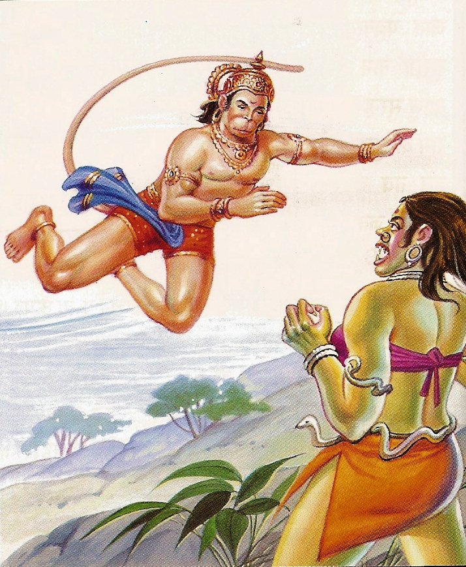

www.sfsai.org

Slide 10
www.sfsai.org

Slide 11




www.sfsai.org

Slide 12
www.sfsai.org

Slide 13
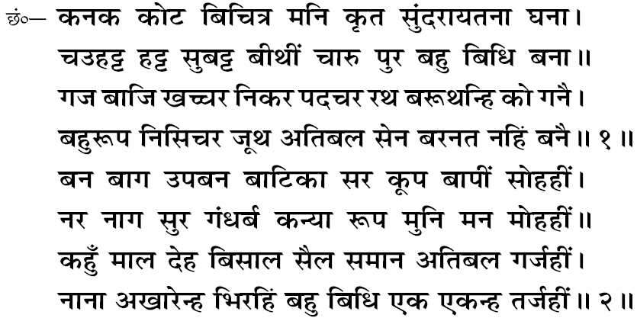
www.sfsai.org

Slide 14

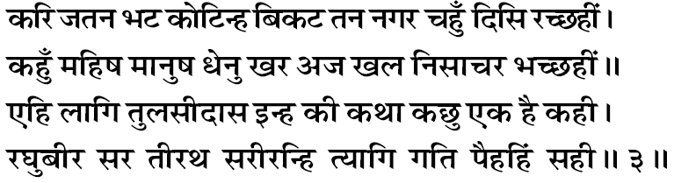
www.sfsai.org

Slide 15

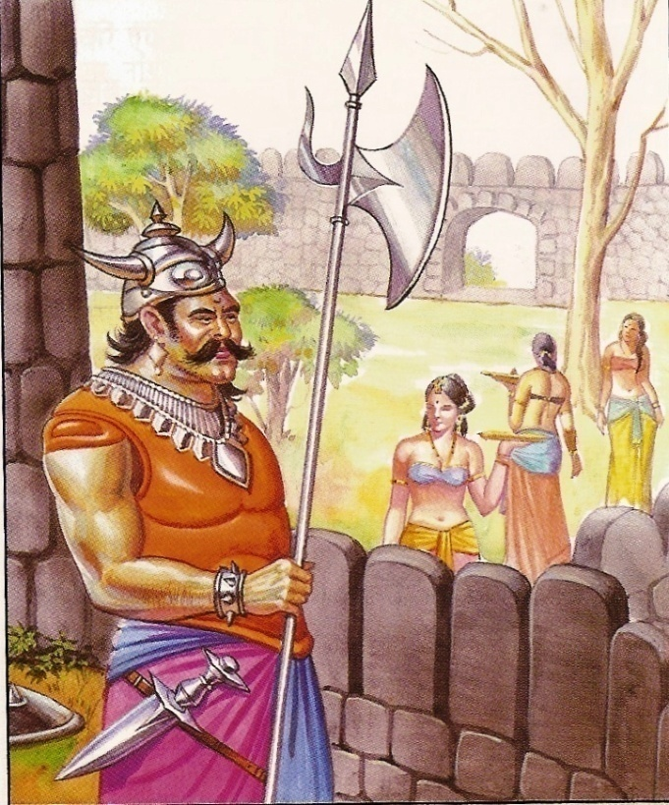
www.sfsai.org

Slide 16

www.sfsai.org

Slide 17

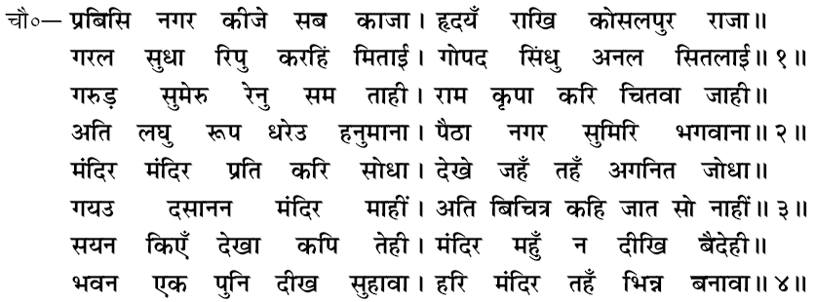
www.sfsai.org

Slide 18


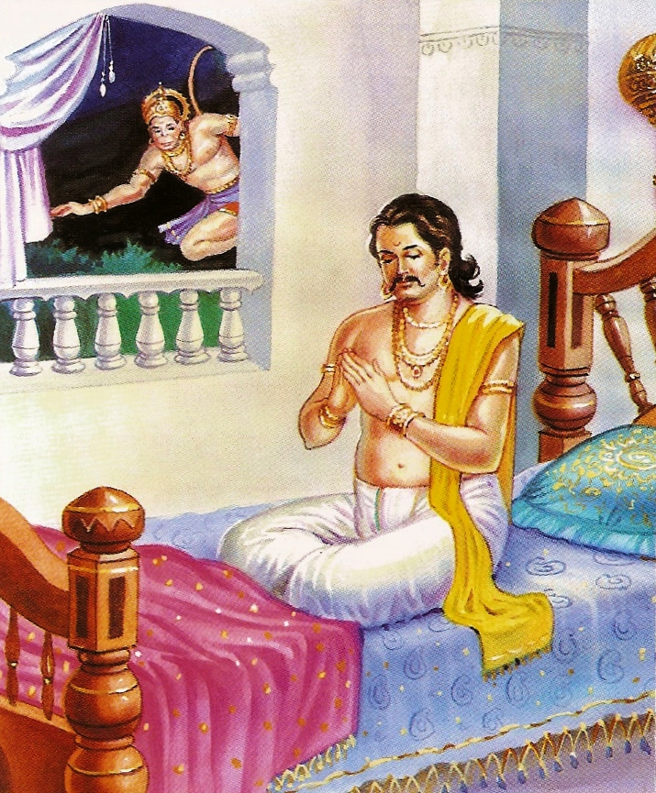


www.sfsai.org

Slide 19
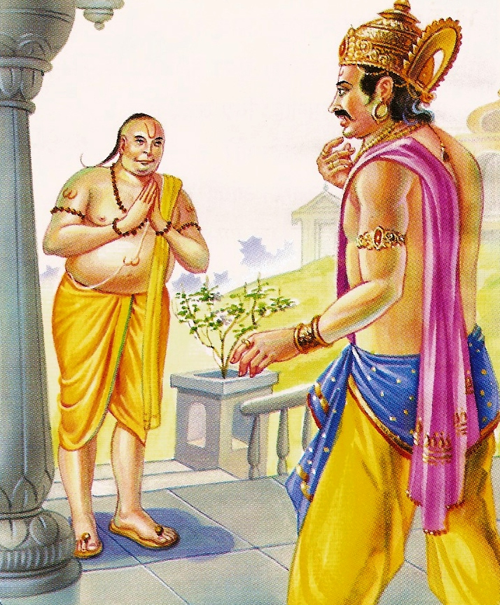




www.sfsai.org

Slide 20

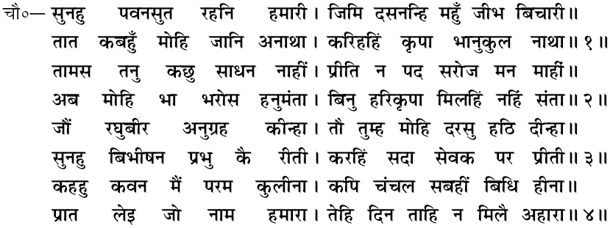
www.sfsai.org

Slide 21

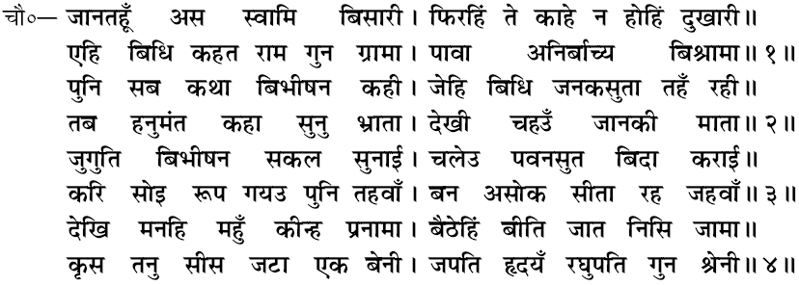
www.sfsai.org

Slide 22

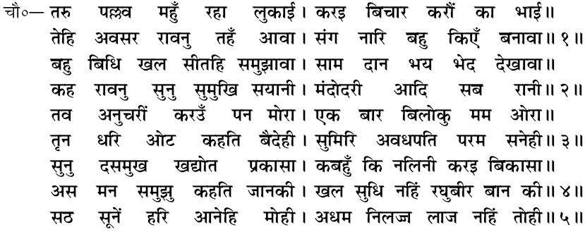
www.sfsai.org

Slide 23

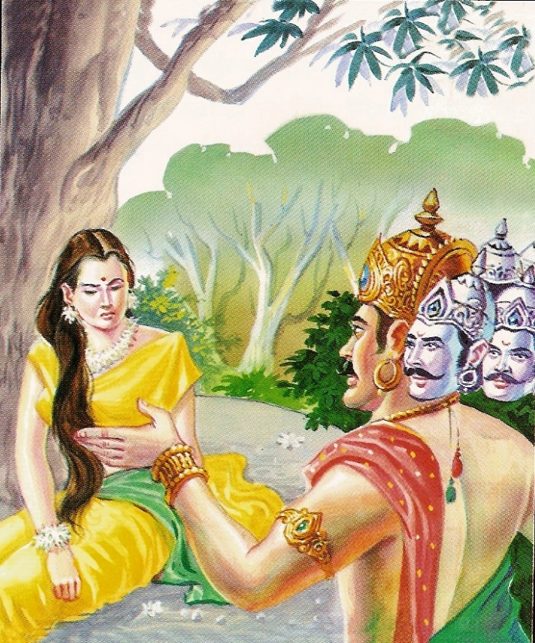
www.sfsai.org

Slide 24

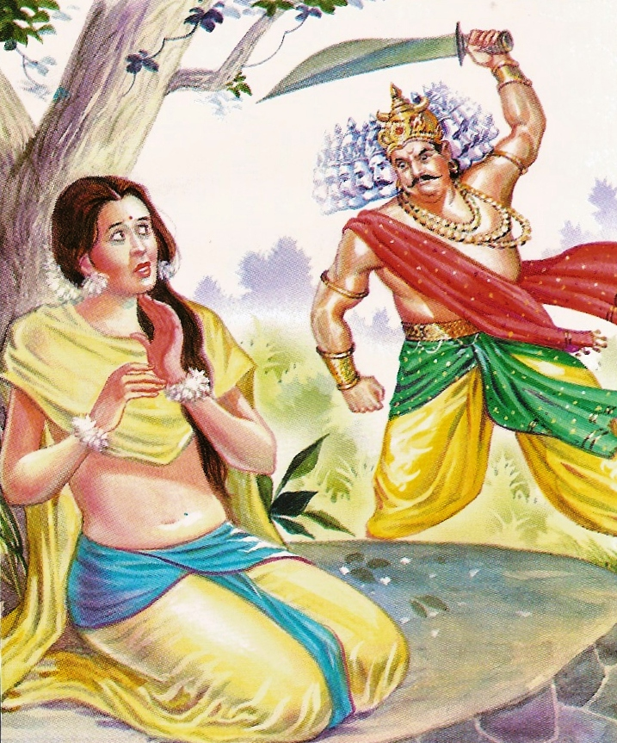
www.sfsai.org

Slide 25

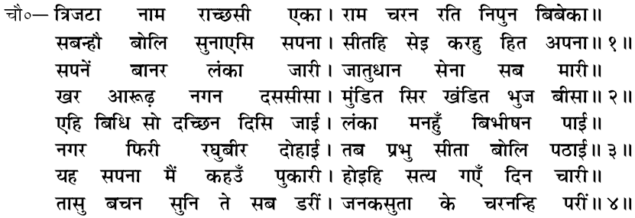
www.sfsai.org

Slide 26
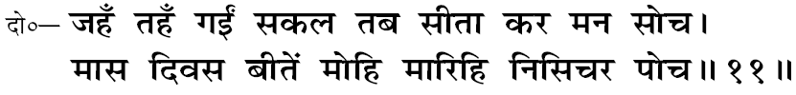
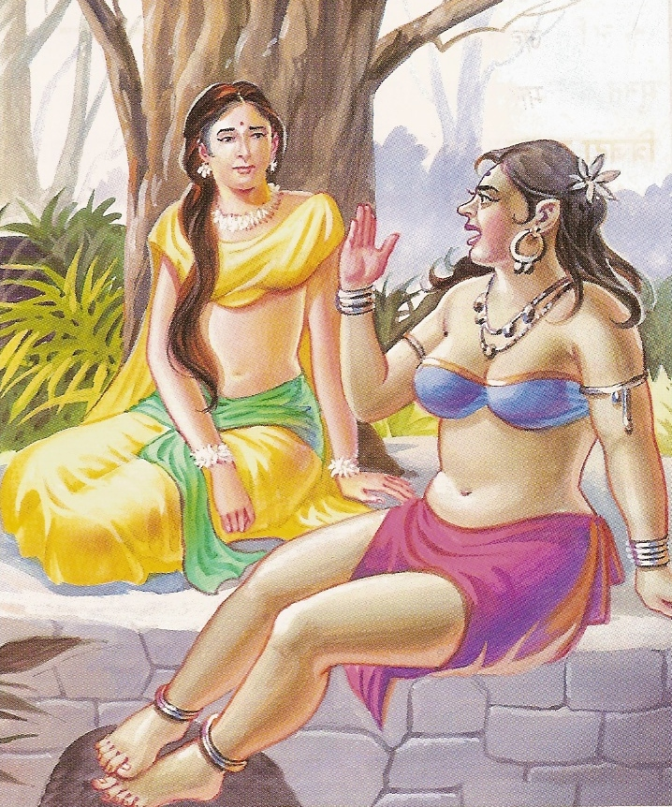
www.sfsai.org

Slide 27
www.sfsai.org

Slide 28

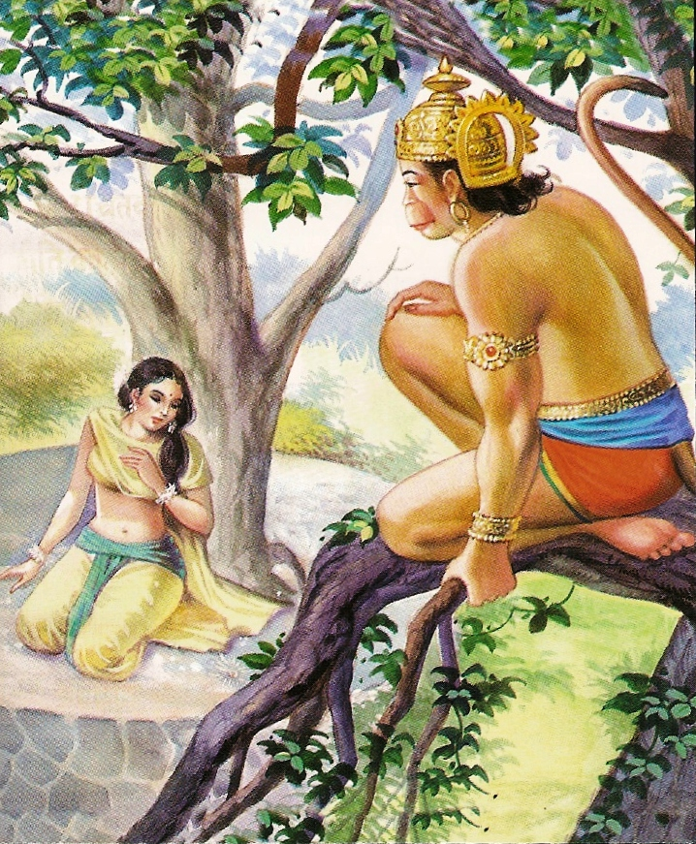


www.sfsai.org

Slide 29



www.sfsai.org

Slide 30

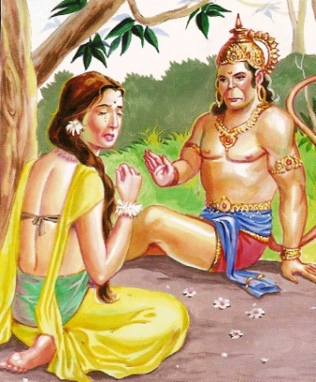

www.sfsai.org

Slide 31



www.sfsai.org

Slide 32

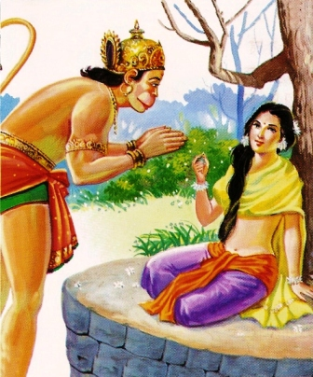



www.sfsai.org

Slide 33

www.sfsai.org

Slide 34

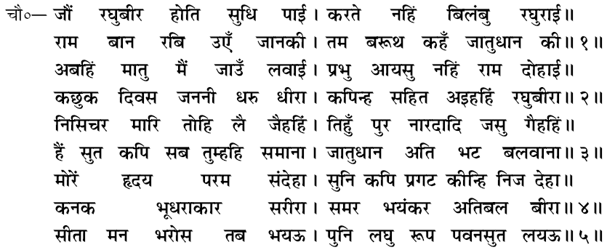
www.sfsai.org

Slide 35

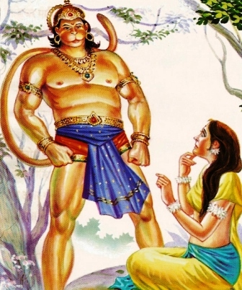

www.sfsai.org

Slide 36
www.sfsai.org

Slide 37
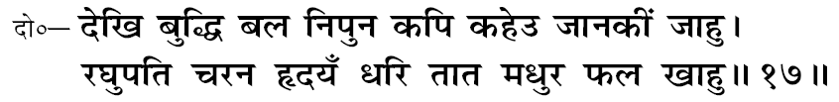
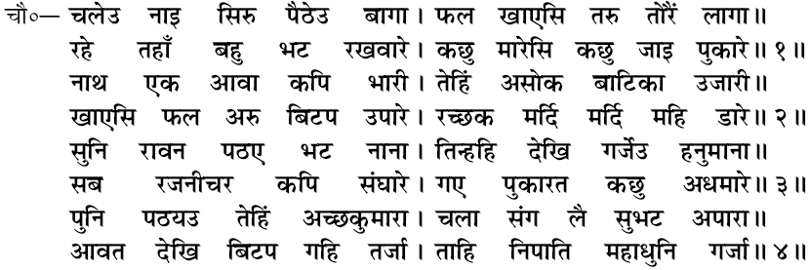
www.sfsai.org
17

Slide 38


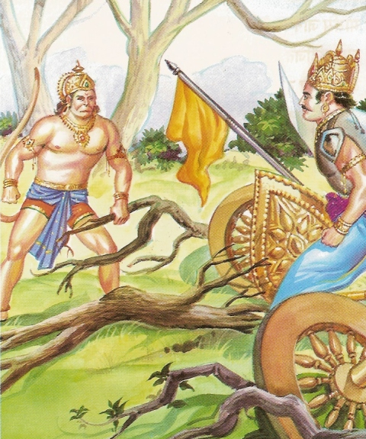
www.sfsai.org
18

Slide 39

www.sfsai.org

Slide 40

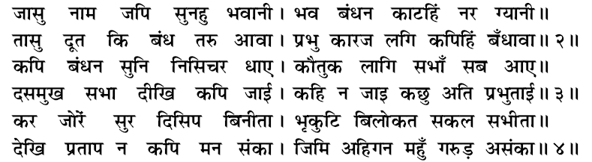
www.sfsai.org
19

Slide 41

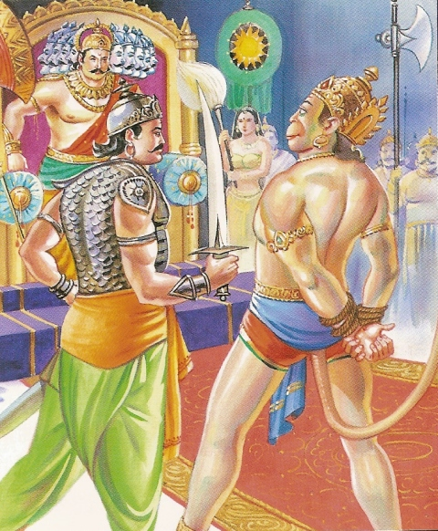
www.sfsai.org
20

Slide 42
www.sfsai.org
20

Slide 43

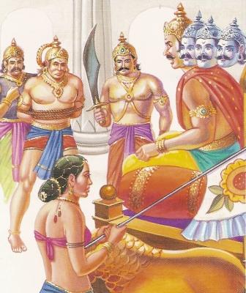



www.sfsai.org
21

Slide 44
www.sfsai.org
21

Slide 45

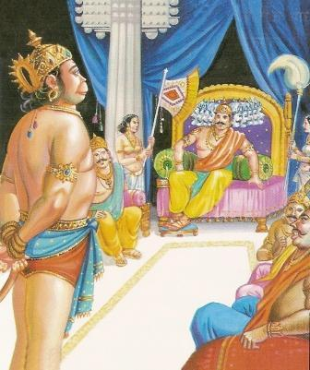

www.sfsai.org
22

Slide 46
www.sfsai.org
22

Slide 47

www.sfsai.org
23

Slide 48
www.sfsai.org
23

Slide 49

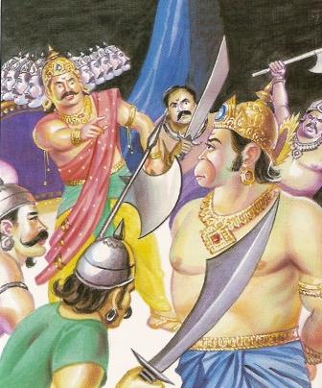



www.sfsai.org
24

Slide 50
www.sfsai.org
24

Slide 51
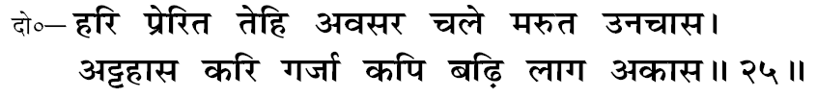
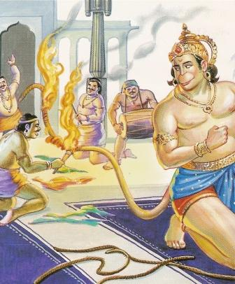
www.sfsai.org
25

Slide 52
www.sfsai.org
25

Slide 53

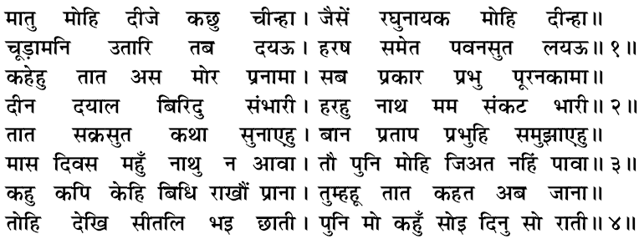
www.sfsai.org
26

Slide 54

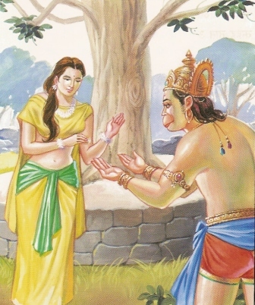

www.sfsai.org
27

Slide 55
www.sfsai.org
27

Slide 56

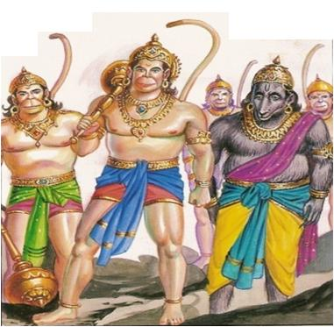
www.sfsai.org
28

Slide 57
www.sfsai.org
28

Slide 58

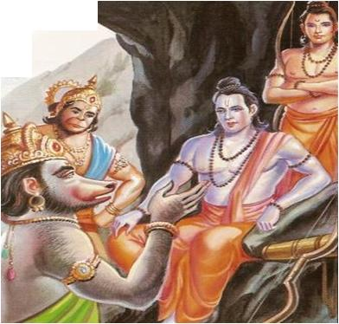

www.sfsai.org
29

Slide 59
www.sfsai.org
29

Slide 60

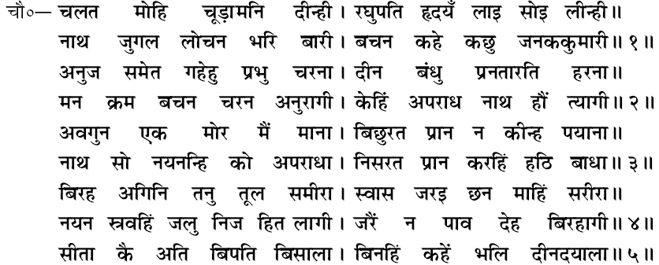
www.sfsai.org
30

Slide 61

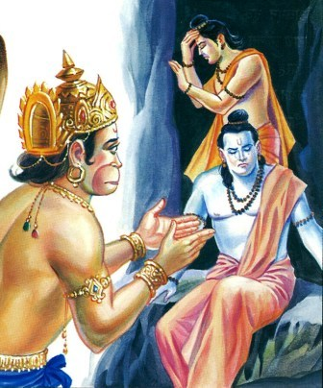
www.sfsai.org
31

Slide 62
www.sfsai.org
31

Slide 63
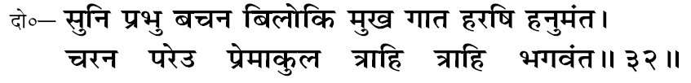
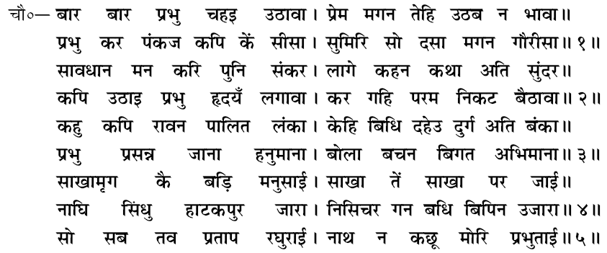
www.sfsai.org
32

Slide 64

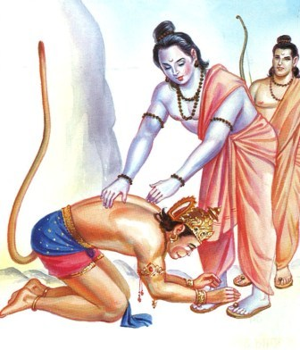

www.sfsai.org
33

Slide 65
www.sfsai.org
33

Slide 66

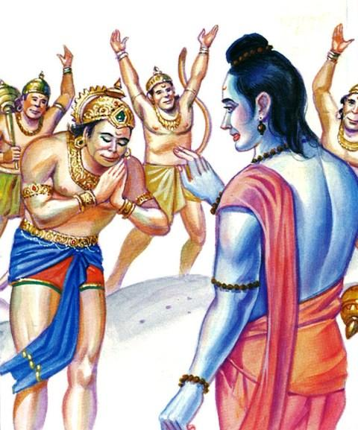


www.sfsai.org
34

Slide 67
www.sfsai.org
34

Slide 68
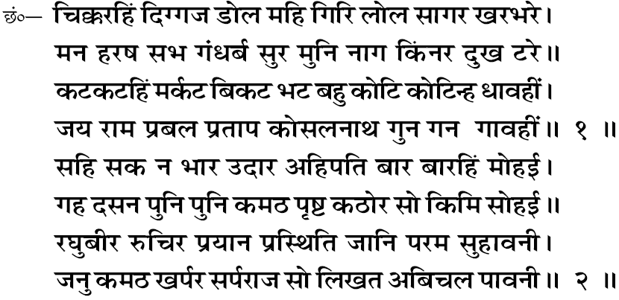
www.sfsai.org
34

Slide 69

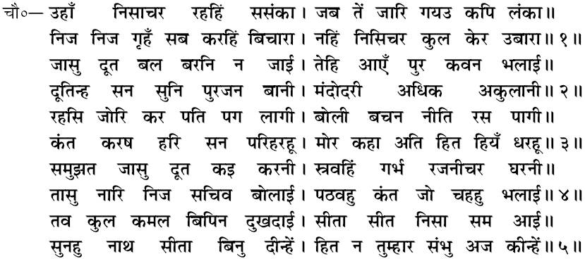
www.sfsai.org
35

Slide 70




www.sfsai.org
36

Slide 71
www.sfsai.org
36

Slide 72






www.sfsai.org
37

Slide 73
www.sfsai.org
37

Slide 74


www.sfsai.org
38

Slide 75


www.sfsai.org
39

Slide 76



www.sfsai.org
40

Slide 77


www.sfsai.org
41

Slide 78


www.sfsai.org
42

Slide 79


www.sfsai.org
43

Slide 80


www.sfsai.org
44

Slide 81


www.sfsai.org
45

Slide 82


,
www.sfsai.org
46

Slide 83


www.sfsai.org
47

Slide 84


www.sfsai.org
48

Slide 85


www.sfsai.org
49

Slide 86


www.sfsai.org
50

Slide 87


www.sfsai.org
51

Slide 88


www.sfsai.org
52

Slide 89


,
www.sfsai.org
53

Slide 90


www.sfsai.org
54

Slide 91



www.sfsai.org
55

Slide 92


56

Slide 93


www.sfsai.org
57

Slide 94


www.sfsai.org
58

Slide 95



www.sfsai.org
59

Slide 96



.
.
.

Slide 97



Slide 99





1
2
3
www.sfsai.org

Slide 100



4
5
6
7
8
www.sfsai.org

Slide 101



9
10
11
12
13
14
15
www.sfsai.org

Slide 102




16
17
18
19
20
21
22
www.sfsai.org

Slide 103




23
24
25
26
27
28
29
www.sfsai.org

Slide 104



30
31
32
33
34
35
36

Slide 105




37
38
39
40
www.sfsai.org

Slide 106


Slide 108


